Slide 1


Stock Value Prediction using Sentiment Analysis
Foundation project 1
Kenny Devarapalli – 12120062 Siddharth Maheshwari – 12120058 Unnati Khinvasara – 12120097 Raktim Prakash Srivastava – 12120044 Anjali Rathore – 12120089

Slide 2
“A prediction about the direction of the stock market tell you nothing about where stocks are headed, but a whole lot about the person doing the predicting.” Random
Warren Edward Buffett
chairman and CEO of Berkshire Hathaway

Slide 3
Contents
Business & Data Understanding | Scope of ML Application | Success Criteria | Feasibility | Data Collection | Data Quality Verification
Data Preparation | Select Data | Clean Data | Construct Data | Standardize data
Modeling | Quality Measures of the Model | Model Selection – Domain Knowledge Model Training – Using LSTM for Time Series Regression | Logistic Regression for Classification
Evaluation | Validate Performance – Using RMSE and R2 for Regression, Accuracy and Recall for Classification
Deployment | Github + Streamlit
Monitoring & Maintenance | Model to be retrained every 1 month and saved in Github
References | References and Citations

Slide 4
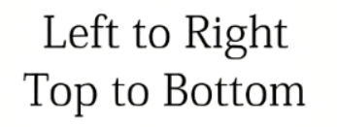





Business and Data Understanding
Scope of ML Application
Business Problem
Low accuracy in the present stock prediction system
Business Objective
Maximize stock prediction accuracy using sentiment analysis
Success Criteria
Business Success Criteria
ROI (using sentiment analysis) 2% higher than ROI (sans sentiment analysis)
ML Success Criteria
ML accuracy for Price prediction model > 65%
Economic Success
Minimum ROI expected to be ~ 10 – 12 % investment horizon

Slide 5






Business and Data Understanding
Feasibility
Applicability of ML technology
Legal constraints
Vader Sentiment Analyzer for Text Analytics
Logistic Regression for Classification
Long Short-Term Model (LSTM) for Time Series analysis
Ordinary Least Squares (OLS) for Regression
The listed companies are mandated to provide financial data (by SEBI and regulating authorities), the same is used for analysis.
Text scraped from the internet would be limited to public opinions (sentiments), financial analysis and commentary for the company.
No insider’s trading data is captured (in form of text or metrics), as it could lead to legal obligations.
Requirements on the application
Robustness Scalability
Explainability Resource Demand

Slide 6


Business and Data Understanding
Data Collection
Data Quality Verification
We have collected two types of data; Text data to perform sentiment analysis and Financial metric data
Sources for Sentiment Analysis
News Website – MoneyWorks, Twitter API, Yahoo Finance
Sources for Financial metrics:
Yahoo finance API
For each company, daily data for 5+ years was collected (i.e., before Jan-2017 to current)
Since data is collected from verified websites, (and from reliable sources), we are certain about the veracity of the information
Sanity check carried out to check for any inconsistency
Financial data required for this project is freely available (for inference & analysis) on NSE/BSE websites, public websites (mirror data like Yahoo Finance), which are quality data sources

Slide 7
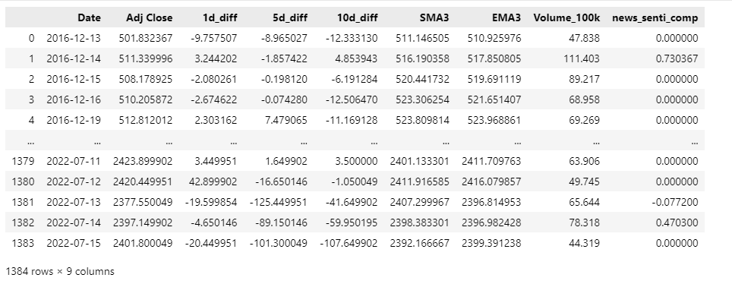
Data Preparation
Select and Clean Data
Features and Data Selection
Date and time of news publication
News title and text
Price as on that day
Data cleaning
News not related to the company is filtered
Where no news for the day, vader score is 0
Feature Engineering
Sentiment Analysis performed on the news to get valance score using Vader library
Financial metrics such historical prices, moving averages (simple & exponential), price differential, volumes, etc explored
Financial metrics such as EMA (Exponential Moving Average) and SMA (Simple Moving Average) are calculated
Additional Features: 1d_diff - difference between that day and the previous day Adj Closing Price

Slide 8
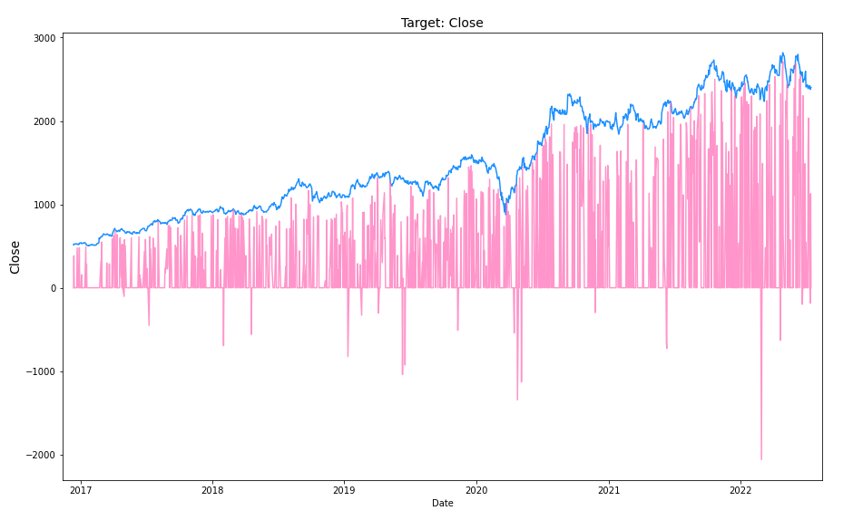
Modeling
Model Quality
Performance: LSTM Model gives an RMSE score of Rs.50 LSTM + OLS gives RMSE of Rs.6
Robustness: Model can handle stock split
Scalability: Azure Cloud to handle scalability in the future
Explainability: To show how much of the stock value change is impacted by the sentiment
Model Selection
Multiple models using Classification, OLS & Neural network (LSTM) have been explored
Model input: Date, News Document sentiment score metrics, stock price metrics (OHLC, SMA, EMA, Volumes)
Model output: Target Date Stock Price basis historical days for prediction

Slide 9
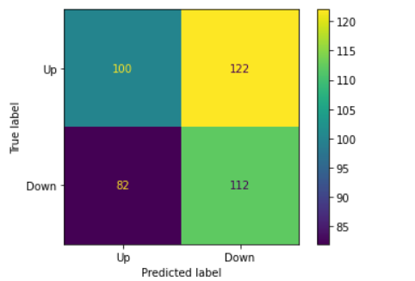
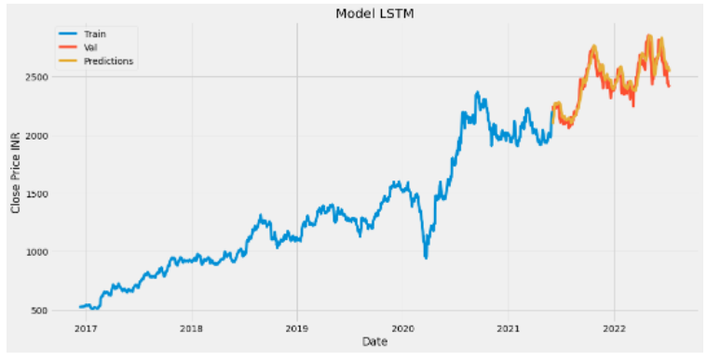
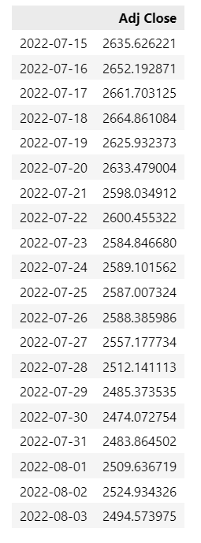
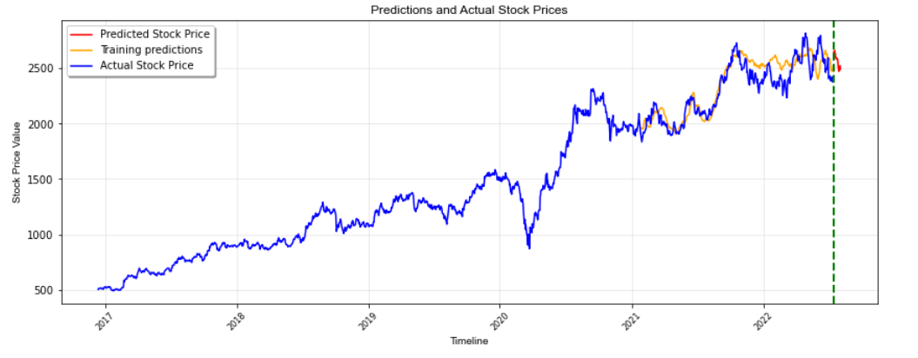
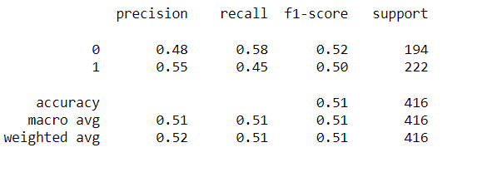
Modelling – Classification LSTM
Classification
LSTM

Slide 10








FLOW FOR ML DEPLOYMENT
Data Sources
Data Storage
Data Pre-processing and Model Building
Sentiment analysis of news
Financial metrics creation
Model Building
LSTM + OLS
Evaluation
Deployment
Monitor
GitHub
GitHub Link : https://github.com/gitsim02/FoundationProject-1

Slide 11
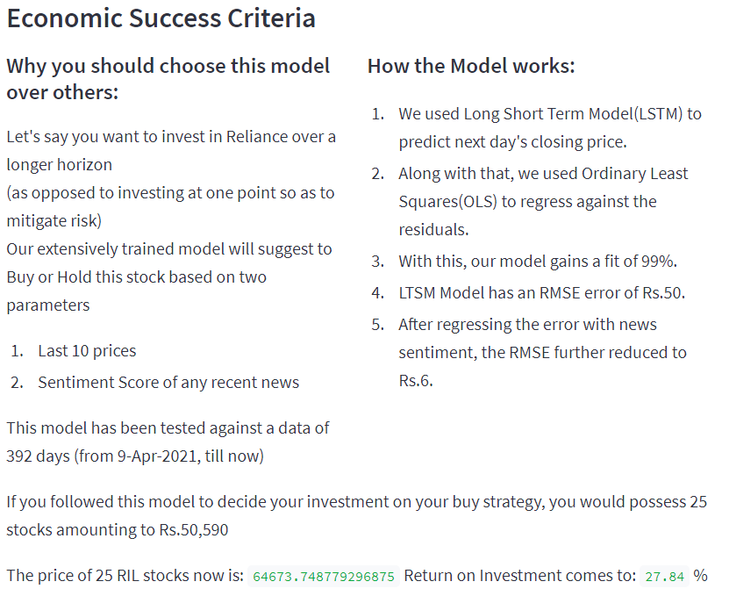
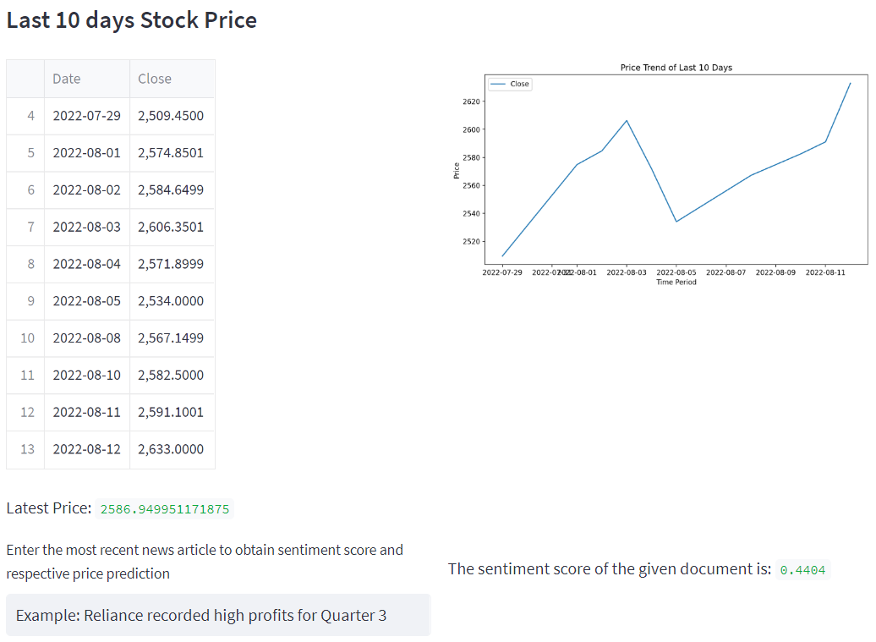
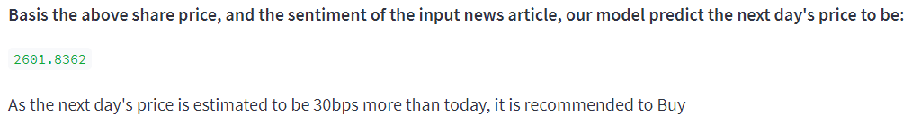
Streamlit Application Output

Slide 12
Thank You

Slide 13
References
https://jfin-swufe.springeropen.com/articles/10.1186/s40854-019-0131-7
https://docs.microsoft.com/en-us/azure/architecture/solution-ideas/articles/azure-machine-learning-solution-architecture
https://medium.datadriveninvestor.com/sentiment-analysis-of-stocks-from-financial-news-using-python-82ebdcefb638
https://www.geeksforgeeks.org/get-financial-data-from-yahoo-finance-with-python/
https://towardsdatascience.com/sentiment-analysis-for-stock-price-prediction-in-python-bed40c65d178
https://tradewithpython.com/news-sentiment-analysis-using-python
https://medium.datadriveninvestor.com/build-a-stock-sentiment-web-app-with-flask-and-deploy-it-online-3930e58a236c
https://www.moneyworks4me.com/stock-markets/search/news/fincode/100325

